Slide 1
Bank Customer Retention Analysis
Wyatt Freeman and Hannah Nobles
11-25-2020

Slide 2
Overview
Customer retention is a primary objective for banks as they compete against a rising number of alternatives such as Venmo and other FinTech applications. There are many variables that factor into a customer’s decision to stay with their bank or leave for alternatives. As Data Analysts, we dug into bank data to find out how well different factors such as Credit Score, Age, and Estimated Salary can predict if a bank customer will leave or not.
Using advanced analytical models, we determined several methods to prevent bank customers from leaving for competitors

Slide 3
Naive Model
The naive model produced 85.99% accuracy when used on the training set with a No Information Rate of 79.63%. The model produced 0.9769 Sensitivity and 0.4025 Specificity. The sensitivity is how well the model detects positives. Specificity is how well the model can detect false alarms. In this case “No” is the positive because we do not want bank customers to exit. The naive model has higher accuracy than other models because the variables have not been tuned.

Slide 4
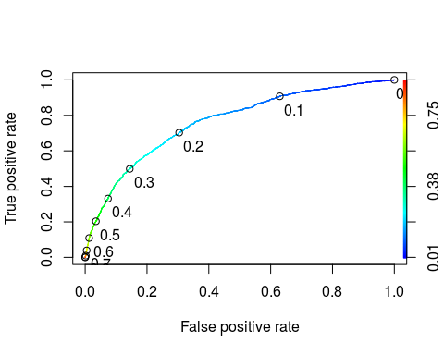
Logistic Regression Model
The logistic regression model produced an AIC of 6053.6, removing several variables. The model quality decreases when more variables are removed or added. The AIC started around 7000, showing a clear improvement in model quality as AIC minimization is the goal.
The ROCR model on the right determined .1924 to be the optimum threshold with a .7259 Sensitivity and a .6784 Specificity. When the threshold was used on the training set, 68.79% accuracy was achieved with .7252 Sensitivity and a .6784 Specitivity. The optimum threshold achieved 69.32% accuracy on the testing set with .7152 Sensitivity and .6876 Specificity.
This model determined that Salary, Credit Scores, and Tenure had no significant impact on customers leaving their banks.

Slide 5
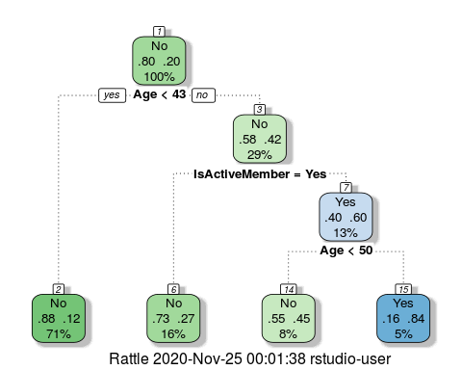
Classification Tree Model
The model produced a tree with 82.66% naive accuracy using a cp of .03436.
When used on the training set, 82.92% accuracy was achieved with a Sensitivity of .9901 and Specificity of .1999.
The model produced 82.36% accuracy on the testing set with a Sensitivity of .9870 and Specificity of .1849.
This model determined Age and Member Activity to be the 2 most important variables when predicting customer exit.

Slide 6
Random Forest Model
This model produced 83.17% naive accuracy. When used on the training set, 83.62% accuracy was achieved with .9973 Sensitivity and .2062 Specificity, the highest accuracy of all models created.
The testing set yielded 83.56% accuracy with .9933 Sensitivity and .2193 Specificity.
The training and testing sets are only .06 apart in accuracy, meaning the model is a good fit for the data
This model determined Age, Number Of Products Used and Member Activity to be the 3 most important variables when predicting if customers will leave or not.

Slide 7
Practical Model Uses to Prevent Bank Customer Exit
The Random Forest Model produced the highest accuracy of all models at 83. 62% when used on the training data set. It determined that Age, Number of Products Used and Member Activity are the most important predictors of customer exit.
We recommend that banks develop a marketing campaign to increase the number of products their customers use, this will simultaneously increase Member Activity.
Customers should be clustered by age. 20-30, 31-40, 41-50, 51-60, and 61+. This will allow banks to promote services to each segment that specifically appeal to that segment. For example, 20-30 year olds are much more interested in establishing credit than other segments and should have credit cards promoted to them. The 61+ segment will be more interested in accessing their retirement funds and should have financial advisory services promoted to them.
Implementing a marketing campaign will increase customer retention by causing them to use more bank products they are interested in. This makes leaving a much bigger hassle, making it less likely to occur.

